Slide 1
Genomic selection, a powerful predictive approach to help in plant breeding Estimation of genetic values of plant genotype candidates to selection : basic criteria for decision in plant breeding

Slide 2
Genetic evaluation
Plant breeding = Crossing the best females with the best males selected within the population
The « best » individuals are those :
which transmit highest superiority for the trait under selection
with the best alleles i.e. those with higher additive genetic values for the trait under selection
Need to estimate (=predict) the genetic additive value
Contrary to GWAS, GS goal is not to identify candidate loci
EBVs = Estimated Breeding Values

Slide 3
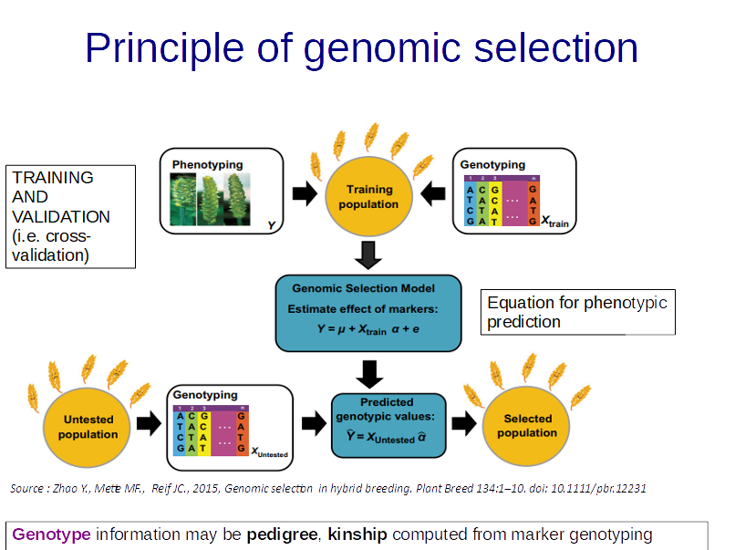

Slide 4
Why Genomic Selection ?
1. Cost of high-trouhgput genotyping is decreasing.
2. Phenotyping is now the more demanding work in genetic analysis and plant breeding (manpower, cost).
3. Simulation & empirical studies have shown better genetic improvement with GS than with traditional selection.
Increasing genetic gain by :
- Increase accuracy of selection (r)
- Decrease generation interval (t)
R = i.r.σ_{A} /t
i : intensity of selection,
r : Accuracy of selection,
σA : Additive genetic variance,
t=time

Slide 5
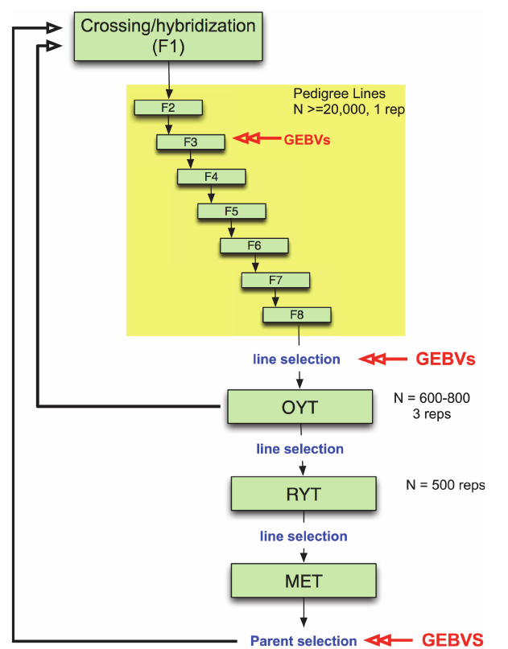
Example of Implementation of GS in Plant Breeding
Spindel J, Begum H, Akdemir D, et al (2015) Genomic Selection and Association Mapping in Rice (Oryza sativa): Effect of Trait Genetic Architecture, Training Population Composition, Marker Number and Statistical Model on Accuracy of Rice Genomic Selection in Elite, Tropical Rice Breeding Lines. PLoS Genet 11:e1004982
Notes:
Fig 2. Example of irrigated rice breeding pipeline that incorporates genomic selection. Parents are selected and crossed to create an F1 population. ~ 20,000 F1 lines are fixed over 7–8 generations with selection of families for heritable traits with *25% of the pedigree lines eventually selected for entry into the observational yield trial (OYT). GEBVs can be used at two or more generations during fixation as resources permit to perform selection. Here we propose using GEBVs at the F3 and F6 generations. GEBVs are also used to select the fixed lines from the F8 to advance to the OYT. The top lines advanced to the OYT based on GEBV are cycled back into the crossing block in order to continue to improve the population. From the OYT, the best performing lines based on phenotype are advanced to the replicated yield trials (RYT), and the best performing lines from the RYT are advanced to the multienvironment trials (MET). Lines from the MET are then selected based on GEBV as parents for the next generation of recurrent selection. Models are buil at each stage in which GEBVs are used for selection based on a subset of the lines in the population (~300 individuals representing different families) that are both genotyped and phenotyped to form the training set. The rest of the individuals in the population are genotyped only in order to calculate GEBVs.

Slide 6
Starting the story : predicting phenotype of sunflower cultivars based on MET data
Dataset created from experimental design described in Roumet et al., 2012, New Phytol.
- Yield data from :
* 6 cultivars
* 5 sites
* 3 years
In a very unbalanced design

Slide 7
Basics of quantitative genetics
The phenotype is controlled by many loci
Each allelic effect is small
Environment plays a part
This is the infinitesimal model
P = M + G + E
P = phenotype of a plant
M = mean of population
G = genotype effect (sum of genetic effects)
E = sum of environmental effects

Slide 8
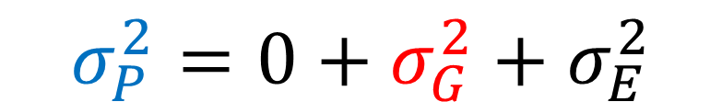
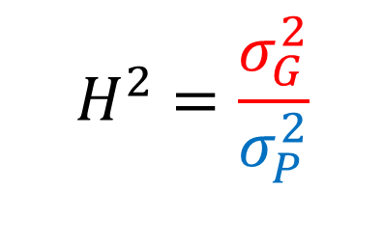
Assessing the proportion of genetic control for a trait
P = M + G + E
$$σ_{P}^{2}=0+σ_{G}^{2}+σ_{E}^{2}$$
The broad-sense heritability is a indication of the genetic control :
$$H^{2}=\frac{σ_{G}^{2}}{σ_{P}^{2}}$$

Slide 9

Starting the story : predicting phenotype using NO molecular markers
Using an experimental design of genotypes evaluated in several environments :
estimate (rough) environmental effect on the phenotype
predict (rough) genetic values
use both information, w/o any additional knowledge of the relationship among accessions to refine the above values
use both information, with additional knowledge of the relationships among accessions using pedigrees (P-BLUP) to refine the above values
Use of MLM because :
the design is highly unbalanced
fixed (environments) and random (genetic values) factors
want to estimate heritability (based on genetic variance)

Slide 10
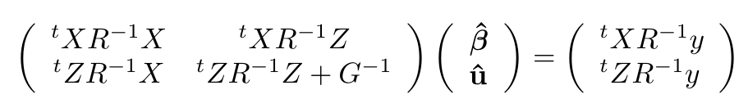
Henderson’s equations
Maximum Likelihood solution
is the solution of :

Slide 11
Henderson’s equations for a Fixed model (y=Xb+e)
Because NO random effects: Z, G and u equal to zero
0
0
0
0
0
Least-Square solution

Slide 12
Henderson’s equations for a Random model (y=µ+Zu+e)
X = 0
0
0
0
0
0
ML solution

Slide 13
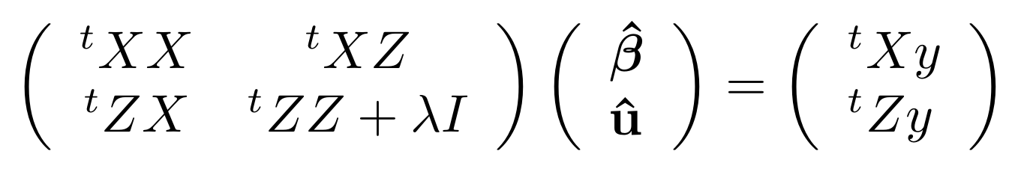
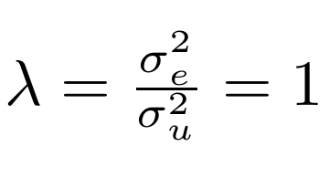
Henderson’s equations with lme4::lmer
and

Slide 14
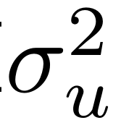
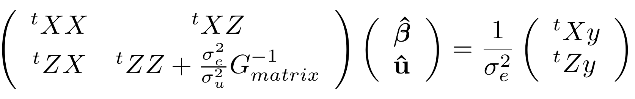
Henderson’s equations in Pedigree-BLUP
G =
A
A
A is estimated from the Pedigrees of the accessions.

Slide 15
Genomic Selection using LMM-based models
Reference Accessions
“New” accessions to predict for phenotype
HT Genotyping
HQ phenotype
HT Genotyping
Compute kinship
G-BLUP models
GEBV-based predicted phenotypes
RR-BLUP models
GS does NOT identify candidate genes

Slide 16
Henderson’s equations in G-BLUP
G =
K
K
K is the realized kinship matrix, estimated using molecular markers

Slide 17
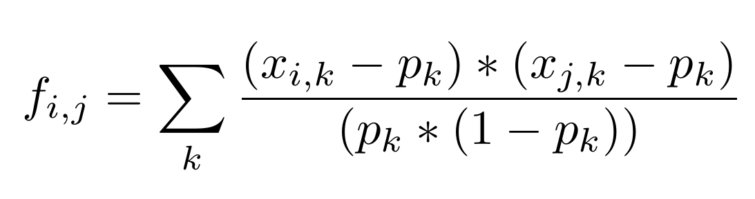
Computing realized kinship from SNPs
'first G' estimator from VanRaden (2008)

Slide 18
Henderson’s equations in RR-BLUP
G =
I
I
Z is the design matrix of all SNPs, and u are the random effects of all SNPs.
The SNPs are considered to be independent (i.e. not in LD or not epistatic).

Slide 19
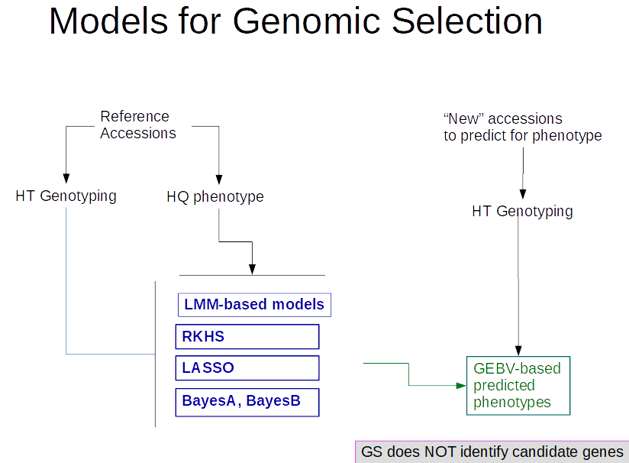

Slide 20
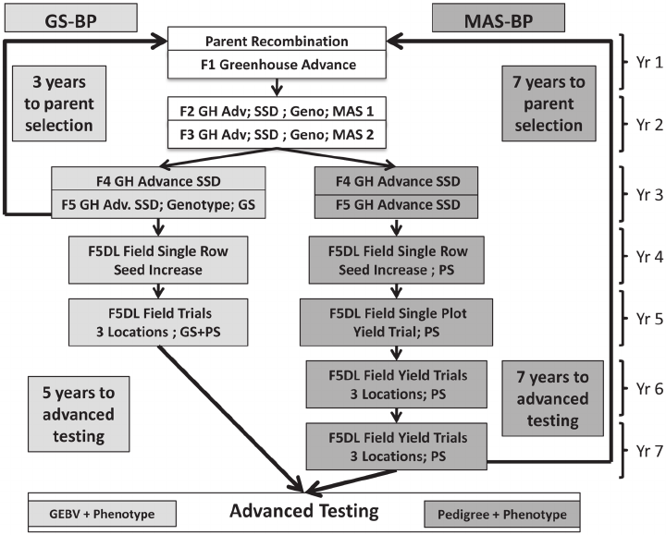
The winter wheat ( Triticum aestivum L.) marker-assisted selection breeding program (MAS-BP) and genomic selection breeding program (GS-BP) schemes.
The GS-BP selection cycle length is 3 yr; whereas, the MAS-BP selection cycle length is 7 yr. Genomic selection breeding program stages are lightly shaded, MAS-BP stages are heavily shaded, and stages common to both programs are not shaded. GH = greenhouse; Adv = advance; Geno = genotyping; PS = phenotypic selection; F5DL = F 5 derived line; GEBV = genomic estimated breeding value.
From Heffner et al, 2010, Crop Science, Plant Breeding with Genomic Selection: Gain per Unit Time and Cost. 50(5) · DOI: 10.2135/cropsci2009.11.0662

Slide 21
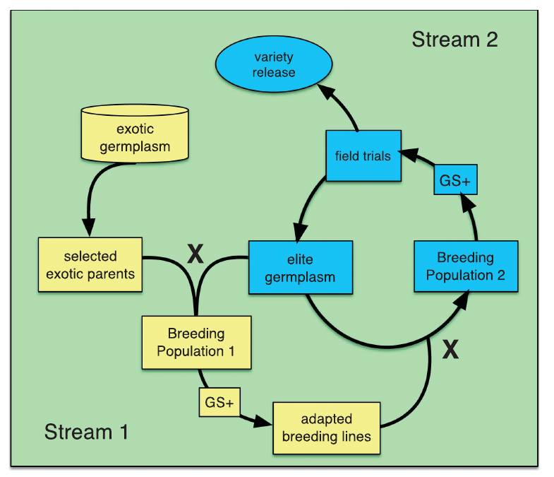
Spindel JE, Begum H, Akdemir D, et al (2016) Genome-wide prediction models that incorporate de novo GWAS are a powerful new tool for tropical rice improvement. Heredity 116:395–408.
Notes:
Figure 6 Diagram of proposed two-stream GS breeding program. Stream 1 (yellow boxes) consists of pre-breeding, in which favorable alleles from exotic
germplasm are introduced into adapted germplasm. Exotic parents are crossed with elite germplasm to develop Breeding Population 1. Selection of
individuals from Breeding Population 1 is performed using a combination of GS + de novo GWAS models (GS+), in which the exotic QTL are fit as fixed
effects, and phenotype. The training population GS would be a subset of breeding population 1, that is, a fraction of breeding population 1 would be
both genotyped and phenotyped, while the rest of breeding population 1 would be genotyped only. Adapted materials from Breeding Population 1 are
crossed into Breeding Population 2 (Stream 2, blue boxes) where they are further refined using GS + de novo GWAS models, where the fixed effects
would include valuable QTL identified based on GWAS performed in Breeding Population 2, the exotic QTL from Stream 1, or any other large effect QTL a
breeder might normally target for trait improvement. Output from Stream 2 can be advanced toward variety release or fed back into Stream 1 to serve as
parents for further crossing and population development.
Here, we describe a new GS model that combines RR-BLUP with markers fit as fixed effects selected from the results
of a genome-wide-association study (GWAS) on the RR-BLUP training data. We term this model GS + de novo GWAS.

Slide 22
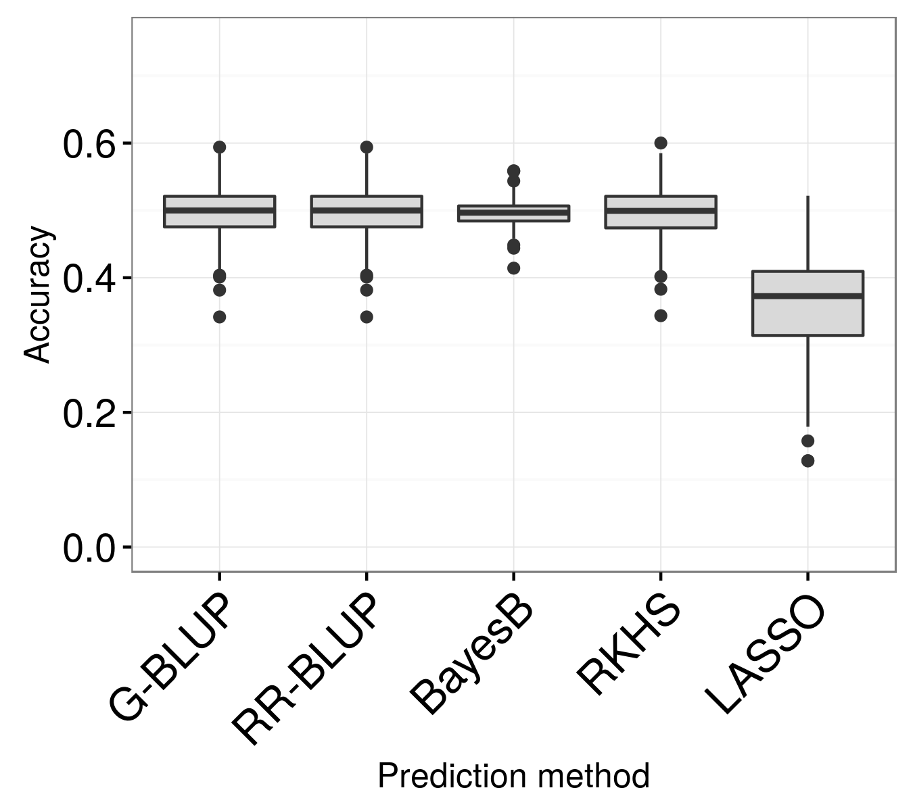
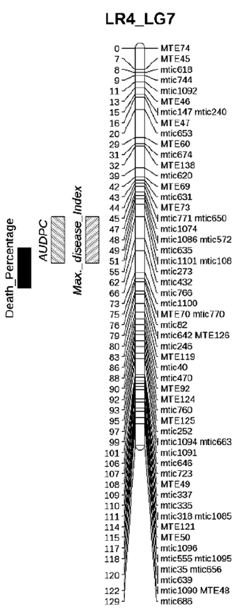
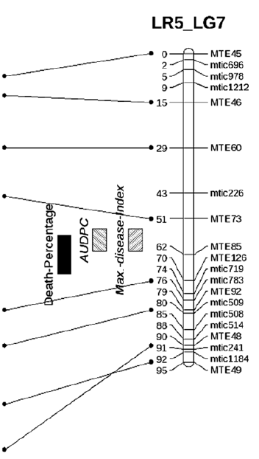
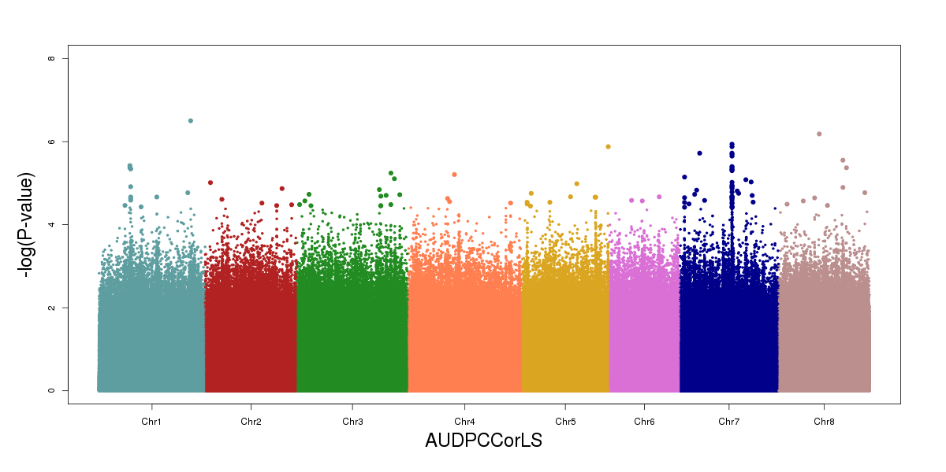
Genomic Selection analysis suggests that additional loci act in establishing this QDR
50% accuracy
840,000 SNPs
Proportional sampling of training set among eight populations
50 rounds of 5-fold cross-validation
QTL analysis : 30% of phenotype for QTL on chrom.7
GWAS : 36 % of phenotype for SNPs on chrom.7
Gentzbittel et al., submitted

Slide 23
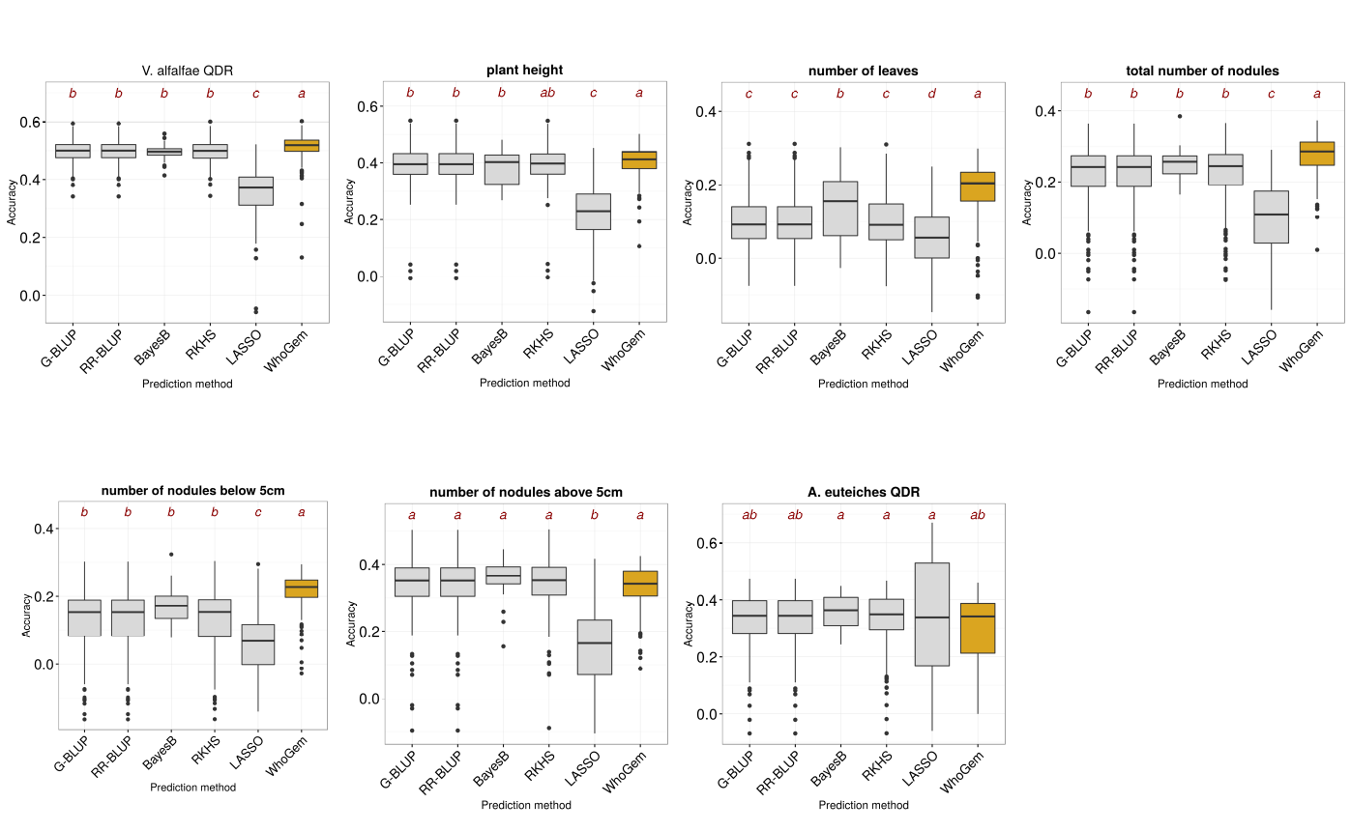
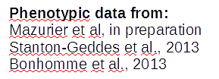
WhoGem models can be significant predictors of quantitative functional traits in plants
Verticillium alfalfae QDR
Plant height
Number of leaves
Total number of nodules
Comparisons of accuracy of prediction for several quantitative traits of adaptive relevance in M. truncatula using 5 Genomic Selection algorithms and our WhoGEM method.
Accuracy is computed using 50 runs of five-fold cross-validation for all methods.
# of nodules below 5cm
# of nodules above 5cm
Aphanomyces euteiches QDR
Gentzbittel et al., Genome biol. , under revision

Slide 24
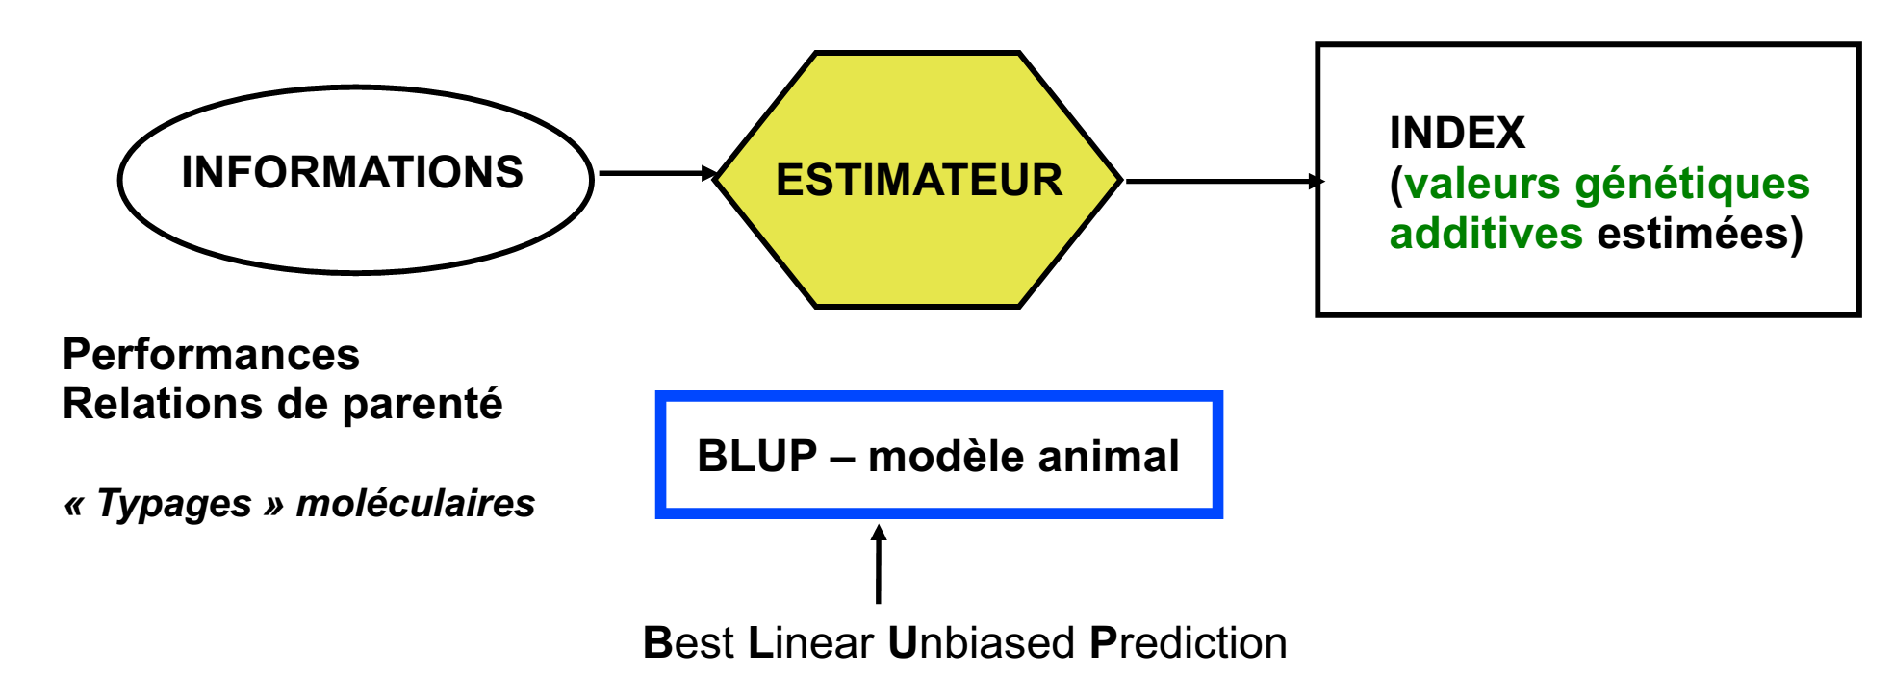
Principle of genetic evaluation

Slide 25
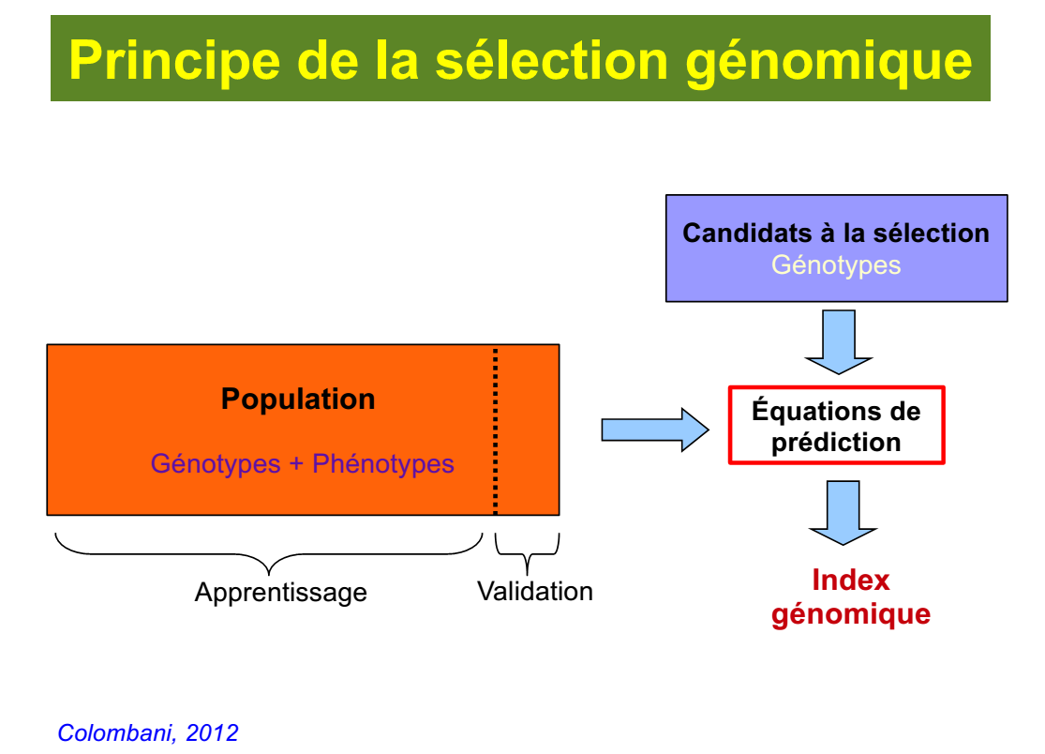
Test Population
Training
(=Training)
Genotype information may be pedigree, kinship computed from marker genotyping

Slide 26
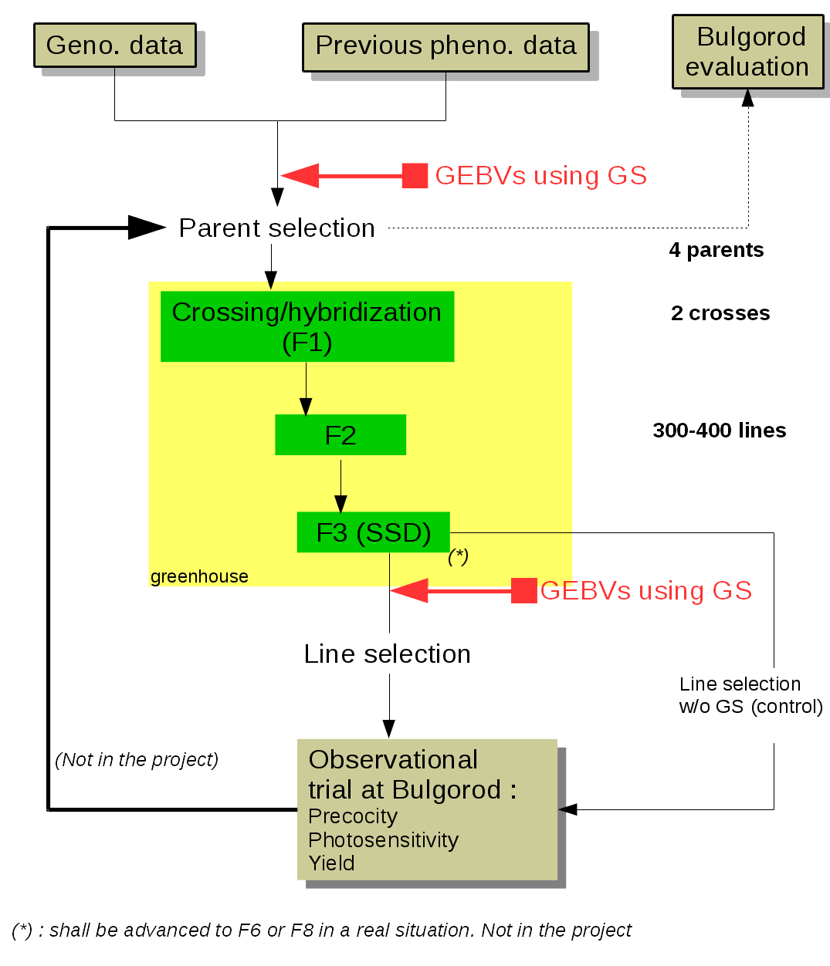
Bien plus modestement : nos propositions pour l’initiation d’une GS chez le soja, en utilisant des données historiques

